Slide 1
Ch. 2- Beginning of Civilization
Section 1: Early Agriculture

Slide 2
Key Terms
Revolution- a complete change in ways of thinking, working, or living
Domesticate- to change the growth of plants or behavior of animals in ways that are useful for humans.
Surplus- more than you need to feed yourself
Specialization- when someone spends more time and becomes an expert at a particular craft or profession
Notes:
Are there any root words here that help you guess the meaning of a word?

Slide 3
Early Agriculture
Neolithic Era
New Stone Age
10,000 years ago
2 to 4 thousand year period
Neolithic Agricultural Revolution- people learned how to farm
Less hunting
People settled in one place
Notes:
What was the biggest change of the Neolithic Era?
Why do you think this change was so important?

Slide 4
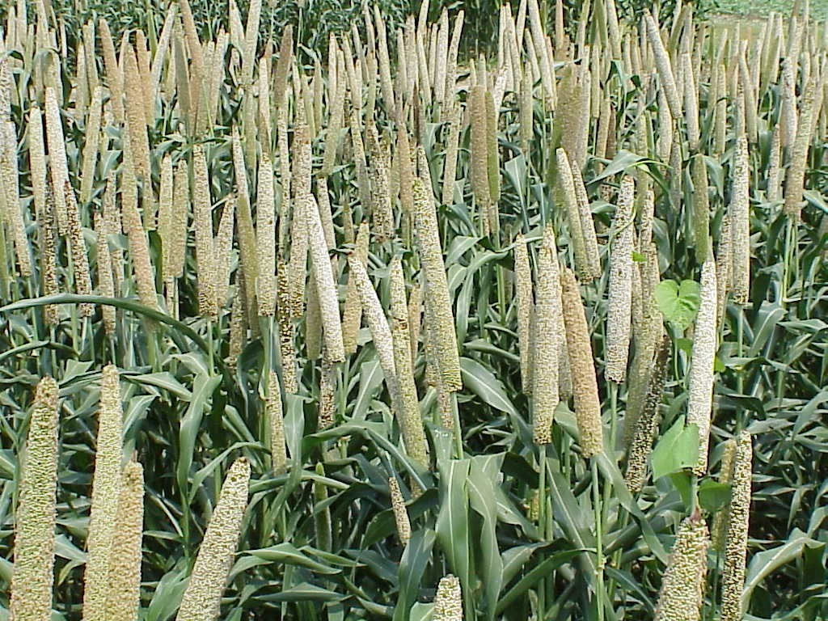
The Birth of Farming
End of Ice Age-> some species died, others adapted
Ppl found other sources of food
Ppl cleared away brush with fire
Ppl discovered how to plant seeds
Grains, fruits, vegetables
Ppl domesticated animals for:
Meat
Labor
Protection
Clothing
Millet
Notes:
What does environment mean?
How did the environment change at the end of the last ice age?
How did people change their environment?
History of Domestication Chart:
When was the first animal domesticated?
When were chickens domesticated?
Were pigs domesticated before or after chickens?

Slide 5
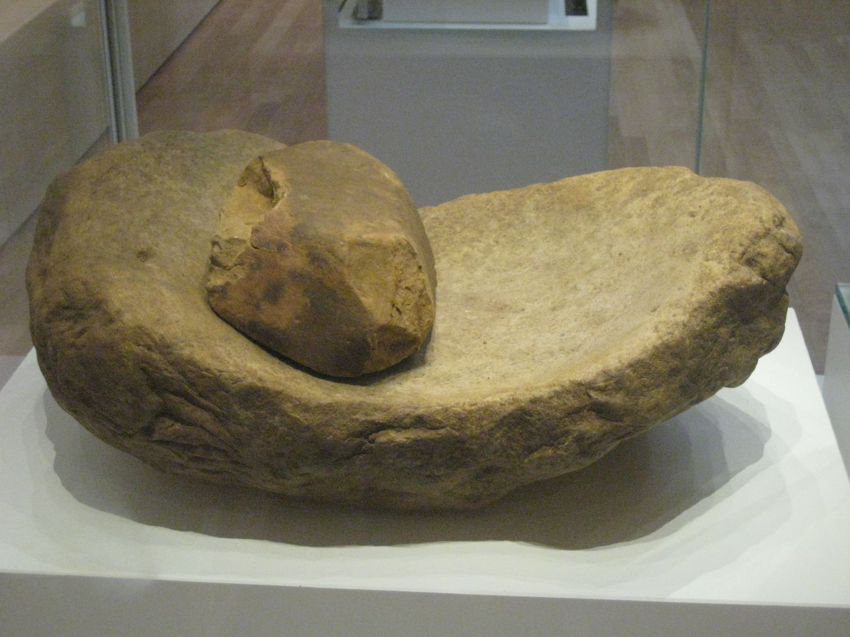
The Birth of Farming
Ppl were SELECTIVE- bred the preferable animals & planted seeds from best crops
New Tools:
Axes to clear trees for more farmland
Sickles to harvest grain
Stone querns
Quern
Notes:
How do you think a quern was used?
What are some differences between wild and domesticated plants? animals?

Slide 6
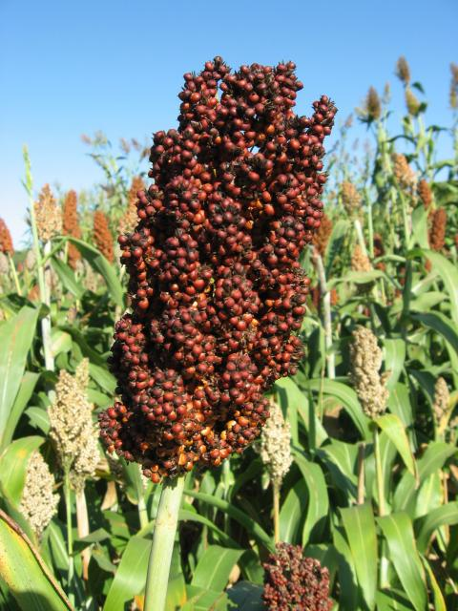
The Spread of Farming
10,000 years ago, Southwest Asia grew wheat, cotton, beans
Chinese agriculture started with rice; further North millet was grown
The Americas domesticated gourds, grew potatoes, beans, and squash
Africa grew sorghum and yams among other crops
Sorghum
Notes:
What might have affected which plants were domesticated?
Map
What are latitude and longitude?
In what latitudes were most early crops domesticated?
Why do you think that is?

Slide 7
The Spread of Farming
Costs of Farming
Required a lot of time and energy
Risk of crop failure
Dangers of attack from nomads
Benefits of Farming
Produced more food
Required less land than hunting
Allowed for permanent settlements and specialization
New sources of material for clothing
Notes:
Why do you think Early humans decided to farm? / Which cost or benefit do you think is most compelling?

Slide 8
New Ways of Living
New kinds of shelter: used mud and straw, which the sun baked and hardened.
Çatalhöyük (chah tahl hyoo YOOK) - 8,000 y.a.
Largest known farming settlement from Neolithic Era
Population: few thousand ppl
Water and building materials were easily available
Tightly packed houses, shared walls, very few streets
Buried dead below floors
Entrances on roofs
Each home had its own kitchen, rich with artwork
Grew grains, raised sheep and goats
Gathered in a large shrine room to worship
Notes:
Why didn’t Neanderthals make their shelters out of mud?
What do roof entrances suggest about the people of catalhoyuk?
How do you think they felt about their community?
How did they protect themselves?
What factors do you think helped Catalhoyuk become an important farming village?

Slide 9
New Ways of Living
New kinds of clothing
Farming provided other materials: cotton, flax, wool, etc
Woven yarn or thread instead of animal furs or hides
Some families could raise a surplus -> population grew
A surplus meant not everyone had to farm
They could specialize in a different craft or skill and trade
Toolmakers
Potters
Weavers
Some metalworkers
Notes:
What kind of material did flax make?
Who traded with whom?
How did farming lead to trade?

Slide 10
New Ways of Living
Social organization
At first, villages stayed small so decisions could be made
Most house were the same size
Permanent residence meant they could own more possessions
Social differences emerged once specialization developed
Notes:
Did these villages have a government?
What kind of decisions did the heads of the household have to make?

