Slide 1
Egypt Under the Pharaohs
Section 1

Slide 2
Key Terms
Cataracts: groups of rocky rapids Delta: an area of sediment-soil or minerals carried by water- deposited at the mouth of a river. Artisan: skilled workers who practice a handicraft Pharaoh: king of a united Egypt Dynasty: ruling family Bureaucracy: a system of offices and officials that handle the business of government Mummy: a body preserved by a special process

Slide 3
The Nile River Valley
The Nile is the world’s longest river (3500 miles)
Starts in East Africa and ends in the Mediterranean
Two sources: Blue and White Niles which meet in Sudan (Nubia)
The Nile passed through cataracts which made it so that no one could sail up the river to East Africa
Deeper in Africa was Upper Egypt (upstream of the Mediterranean Sea)
Closer to the Mediterranean sea was Lower Egypt

Slide 4
The Nile River Valley (Continued)
The Nile carries Silt from the sources all the way to the end of the river
The silt that is dropped at the mouth (end) of the river forms the fertile Nile River Delta
The silt was also dropped along both sides of the river causing that area to be fertile too
The fertile area had black soil and was called “Kemet” (The Black Land)
During the rainy season in East Africa, lots of water poured from the sources into the Nile and flooded the river
If there was too much the soil would be carried away with the water
If there was too little there would be a drought and crops wouldn’t grow

Slide 5
Civilization Develops
Over 7,000 years ago people began to grow crops in the Black Land
To grow more food farmer would build walls of dirt to trap the water
This water would absorb into the soil and help crops grow
It made more food than one family could eat and this is a crop surplus
Powerful people would collect that surplus as a tax
They would use this to buy luxuries from artisans
Because they was so much surplus food those artisans could make luxuries full time to trade for the food and feed their families
Those Artisans would then live near the rulers and then these few houses became more and more until it was a city
Cities brought together skilled people
These cities were places of culture and power

Slide 6
The Kingdoms of Egypt
In 3000 B.C. there were two kingdoms in Egypt
Upper Egypt
These kings wore white crowns
Lower Egypt
These kings wore red crowns
Narmer was the man who united the two kingdoms and combined the two crowns into one red and white one
He established the first dynasty (a ruling family)
Kingdoms: Old, Middle, New
Old: a time of prosperity
Middle: building of canals to contain the floods and use them to grow more crops
New: Conquering of more land outside of Egypt
Eventually weakened then broke apart then was invaded by many peoples
Government
Bureaucracy with the head being the Vizier
They took care of the taxes and gave surplus crops to the people that worked for the Pharaoh.

Slide 7
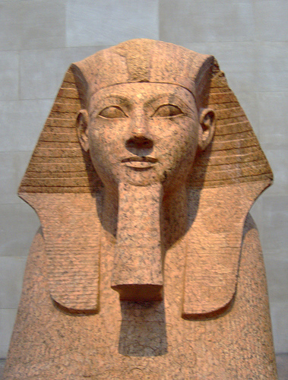
Two Great Rulers
Hatshepsut
She took over ruling because her husband died and his son was too young to rule
Since she was a woman some people did not want to obey her
So she did what was expected of a king
She dressed like the king
She wore a false beard
She ruled over a peaceful time where Egypt gained money and power through trading

Slide 8
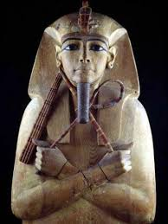
Two Great Rulers (Continued)
Ramses II
He chose to go to war to get money and power
He fought against the Hittites
He eventually made peace and established a border with them
He also built more monuments than any other pharaoh during his lifetime

Slide 9
Egyptian Society
The society provided loyalty to the Pharaoh and Order
It was shaped like the Pyramid
Top: Pharaoh (Living God)
Nobles, Priests, and Officials (helped govern through bureaucracy)
Scribes (helped keep the bureaucracy running)
Merchants and Artisans (provided skilled labor and goods)
Farmers, Servants, Slaves (farmed and did hard labor)

Slide 10
Egyptian Religion
Egyptians believed their gods controlled everything
To please them they would build temples, give gifts, and offer prayers
Polytheists
They believed in many gods
Amon-Ra: God of the Sun
Osiris: God of Death
Seth: Killed and chopped Osiris into pieces
Isis: Wife of Osiris, she put him back together
Horus: Son of Isis and Osiris, battled and killed Seth and United the two Kingdoms of Egypt
It is believed that the Pharaoh is Horus in human form
So the Pharaoh is a living God

Slide 11
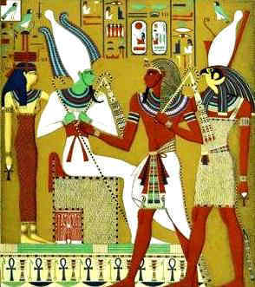
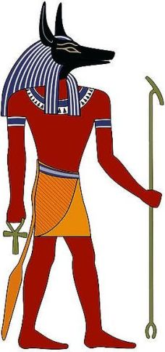

Slide 12
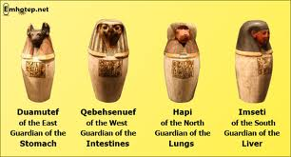
Egyptian Religion (Continued)
Priests would serve the Pharaoh and thus help people gain favor with the living god
Egyptians thought that once dead they can be reborn like Osiris but, he decided who could.
He would let the good live again but the sinful would not
Their body would need to be preserved so their spirit could find their body and live in it again
However, the poor did not have their bodies mummified. They were buried in the desert for their bodies to dry out in the heat.

Slide 13
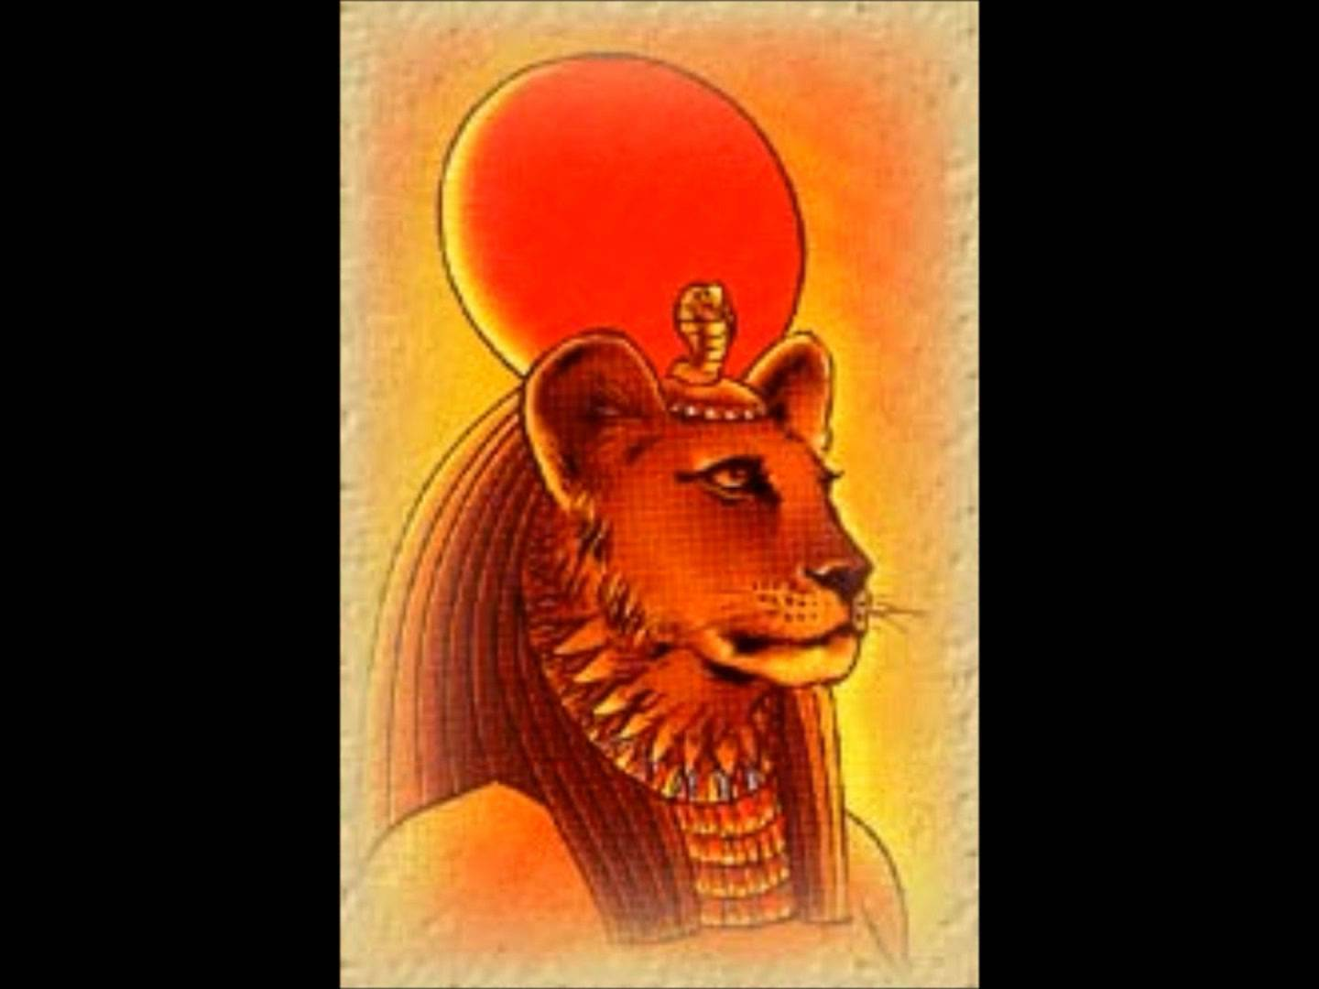
Section 1 Assessment Questions
On page 151, do the assessment questions 1-8. Write down the questions and the answers in your spiral.
(Sekhmet, the warrior goddess as well as goddess of healing. She is depicted as a lioness, the fiercest hunter known to the Egyptians.)

