Slide 1
Empire/Civilization Poster Project
Name:
This project will be counted as a test grade and a participation grade. You will be assessed on your ability to work well with others, stay focused and on task, and create a beautiful, thoughtful representation of historical information. You will be assigned an empire or civilization and a group to create a poster for.
These elements MUST be on your poster:
The name of your empire/civilization
The time period of your empire/civilization
The region of your empire/civilization:
Describe geographically where and which city/cities were in it
Shade or highlight on given map
Achievements of your empire/civilization: technology developed, unique accomplishments, legacy
Government: who ruled this empire/civilization and when, how was it structured, how was it ruled
Culture: daily life, religion, social class, art, literature, architecture, etc
Conflict: Were there any wars/battles/conflicts during this empire/civilization? Who won? How?
At least three illustrations or pictures showing something described on your poster (NOT including map)
These descriptions MUST be written in complete sentences, neatly written, grammatically correct.
Show me your BEST WORK

Slide 2
Poster Layout
Empire/Civilization Name
Region: describe where your civilization was, which cities were in it
[Time period of civilization]
Conflict: Were there any wars/battles during this empire/civilization? Who won? How?
Map, with areas highlighted
Culture:
Describe the culture of your civilization: social class, daily life, religion, art. What kind of art did this civilization create? Did they create any well-known literature or architecture?
Picture for Arts or Gov’t
Achievements:
New technology, unique characteristics, what was this civilization known for?
Government:
How was your civil. ruled? Who ruled? How was the gov’t structured?
Illustration/ picture for culture
Accomplishment illustration/picture

Slide 3
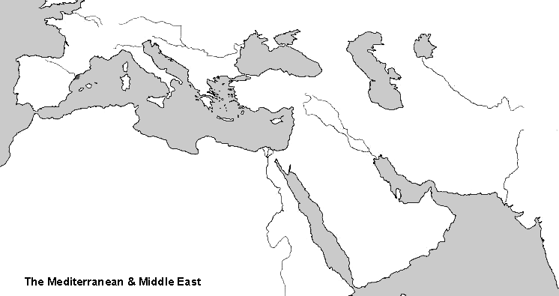
Cut out this map and use on your poster by highlighting or neatly shading the region of your empire/civilization.

Slide 4
My Project
My empire/civilization:_______________________________________________________
My group: ________________________________________________________________
Responsibilities:
Culture _____________________________________________________________
Government_________________________________________________________
Achievements _______________________________________________________
Conflict_____________________________________________________________

Slide 5
Reflection:
I cooperated with my team by: ____________________________________________________________________________________________________________________________________________________________________________________________________________________________________________________________
I contributed to the project by: ____________________________________________________________________________________________________________________________________________________________________________________________________________________________________________________________
I was on task and focused throughout this project (circle one): Never Sometimes Mostly Always
Was this your best work? Why or why not? ________________________________________________________________________________________________________________________________________________________________________________________________________________________________________________________________________________________________________________________________________________

